Slide 1

SQL INNER JOIN Chapter 001

Slide 2
SQL INNER JOIN Chapter 001
SQL has the possibility of working with data across multiple tables at the same time.

Slide 3
SQL INNER JOIN Chapter 001
SQL has the possibility of working with data across multiple tables at the same time.
SQL Joins have the power of linking tables together.

Slide 4
SQL INNER JOIN Chapter 001
The common form of a join is the SQL inner join.

Slide 5
SQL INNER JOIN Chapter 001
The common form of a join is the SQL inner.
It’s the default SQL join you get when you use the join keyword only.

Slide 6
SQL INNER JOIN Chapter 001
The common form of a join is the SQL inner.
It’s the default SQL join you get when you use the join keyword only.
The result of the SQL inner join includes rows from both the tables where the join conditions are met.

Slide 7
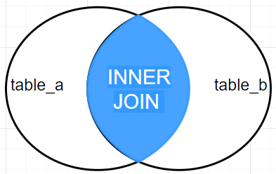
The Venn diagram representation of INNER JOIN is shown below.

Slide 8
The Venn diagram representation of INNER JOIN is shown below.
SELECT *
FROM table_a
INNER JOIN table_b
ON table_a.fkID = table_b.ID

Slide 9
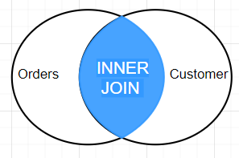
The Venn diagram representation of INNER JOIN is shown below.
ORDERS
CUSTOMER
orderid | customerid | employeeid | orderdate | price
10408 | 2 | 7 | 10/19/2022 | 164.78
10409 | 2 | 5 | 10/20/2022 | 200.78
1010 | 1 | 6 | 10/21/2020 | 300.78
customerid | customername | address | city | postalcode | country
1 | Mario | Flager ave. 107 | Doral | 33176 | United States
2 | Luis | Calle 8 Str. 8 | Miami | 33172 | United States
3 | John | Coral Gables Str. 8 | Miami | 33174 | United States
SELECT OrderID, CustomerName, Price
FROM Orders
INNER JOIN Customer
ON Orders.CustomerID = Customer.CustomerID;

Slide 10
The Venn diagram representation of INNER JOIN is shown below.
ORDERS
CUSTOMER
orderid | customerid | employeeid | orderdate | price
10408 | 2 | 7 | 10/19/2022 | 164.78
10409 | 2 | 5 | 10/20/2022 | 200.78
1010 | 1 | 6 | 10/21/2020 | 300.78
customerid | customername | address | city | postalcode | country
1 | Mario | Flager ave. 107 | Doral | 33176 | United States
2 | Luis | Calle 8 Str. 8 | Miami | 33172 | United States
3 | John | Coral Gables Str. 8 | Miami | 33174 | United States
SELECT OrderID, CustomerName, Price
FROM Orders
INNER JOIN Customer
ON Orders.CustomerID = Customer.CustomerID;
RESULT:
orderid | customername | price
10408 | Luis | 164.78
10409 | Luis | 200.78
1010 | Mario | 300.78

Slide 11
The Venn diagram representation of INNER JOIN is shown below.
ORDERS
CUSTOMER
orderid | customerid | employeeid | orderdate | price
10408 | 2 | 7 | 10/19/2022 | 164.78
10409 | 2 | 5 | 10/20/2022 | 200.78
1010 | 1 | 6 | 10/21/2020 | 300.78
customerid | customername | address | city | postalcode | country
1 | Mario | Flager ave. 107 | Doral | 33176 | United States
2 | Luis | Calle 8 Str. 8 | Miami | 33172 | United States
3 | John | Coral Gables Str. 8 | Miami | 33174 | United States
SELECT OrderID, CustomerName, Price
FROM Orders
INNER JOIN Customer
ON Orders.CustomerID = Customer.CustomerID;
RESULT:
orderid | customername | price
10408 | Luis | 164.78
10409 | Luis | 200.78
1010 | Mario | 300.78

Slide 12
The Venn diagram representation of INNER JOIN is shown below.
ORDERS
CUSTOMER
orderid | customerid | employeeid | orderdate | price
10408 | 2 | 7 | 10/19/2022 | 164.78
10409 | 2 | 5 | 10/20/2022 | 200.78
1010 | 1 | 6 | 10/21/2020 | 300.78
customerid | customername | address | city | postalcode | country
1 | Mario | Flager ave. 107 | Doral | 33176 | United States
2 | Luis | Calle 8 Str. 8 | Miami | 33172 | United States
3 | John | Coral Gables Str. 8 | Miami | 33174 | United States
SELECT OrderID, CustomerName, Price
FROM Orders
INNER JOIN Customer
ON Orders.CustomerID = Customer.CustomerID;
RESULT:
orderid | customername | price
10408 | Luis | 164.78
10409 | Luis | 200.78
1010 | Mario | 300.78

